Slide 1

Tutor.com 101
For Faculty
24/7 Tutoring to Help You Succeed in College
Welcome CUNY City Tech!

Slide 2
About Us
Educational partner to thousands of schools,
libraries, school districts, and branches of the DOD
Experts in more than 250 academic subjects and test-prep areas
Provider of more than 24 million
1-to-1 tutoring sessions since 2000
Service of The Princeton Review
since 2014

Slide 3
The Student Experience
Notes:
Now let’s look at what your students will experience when they log on to Tutor.com.

Slide 4
Flexible Tutoring Options
Drop in anytime for an unscheduled, on-demand session 24/7/361 | Schedule a 30 or 60-minute appointment with the tutor of your choice | Drop off an essay and receive detailed feedback within 12 hours | Take a diagnostic quiz and review your missed questions with a tutor in seconds | Find resume and interview resources to help you land that job

Slide 5
How You Access Tutor.com
Log in
To Blackboard
Scroll
Down to My Organizations
Click
On Here if You Need Tutoring
Click
On How to Schedule a Tutor

Slide 6
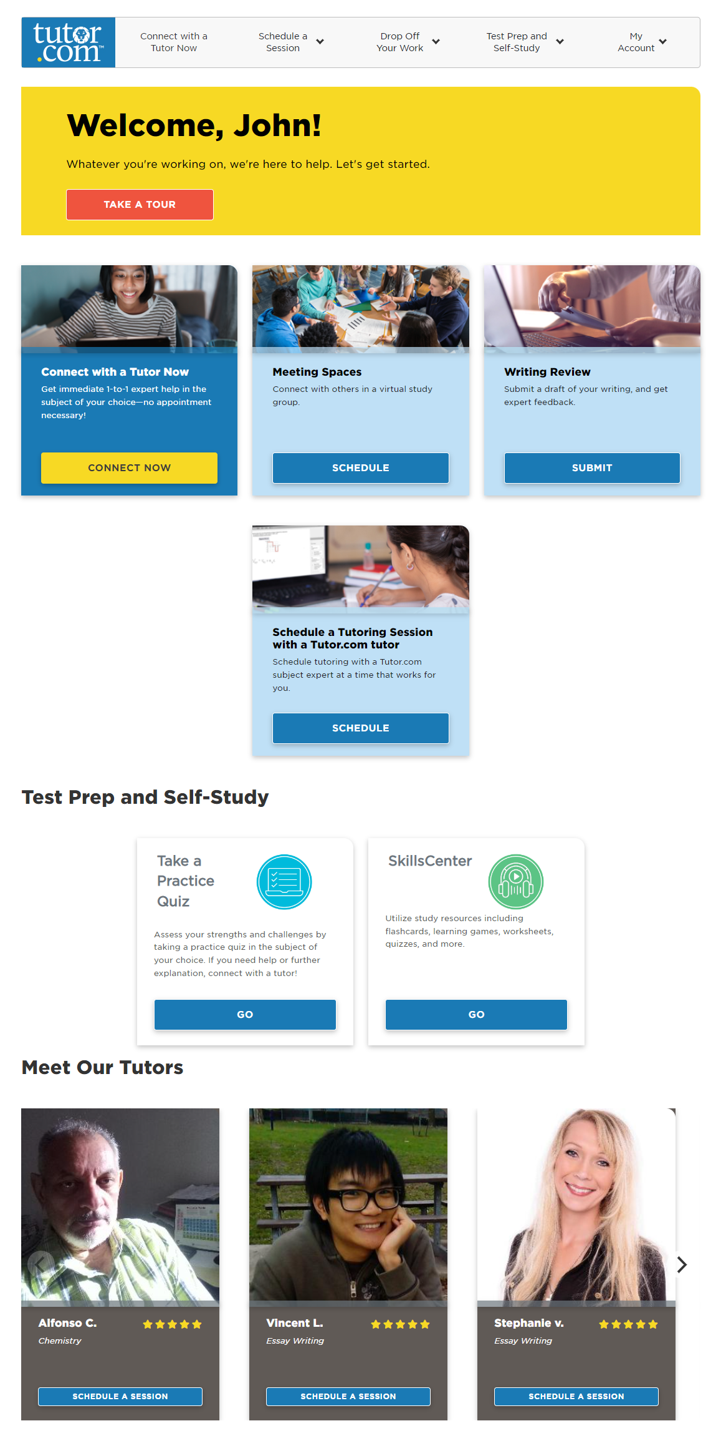
New Student Home Page

Slide 7
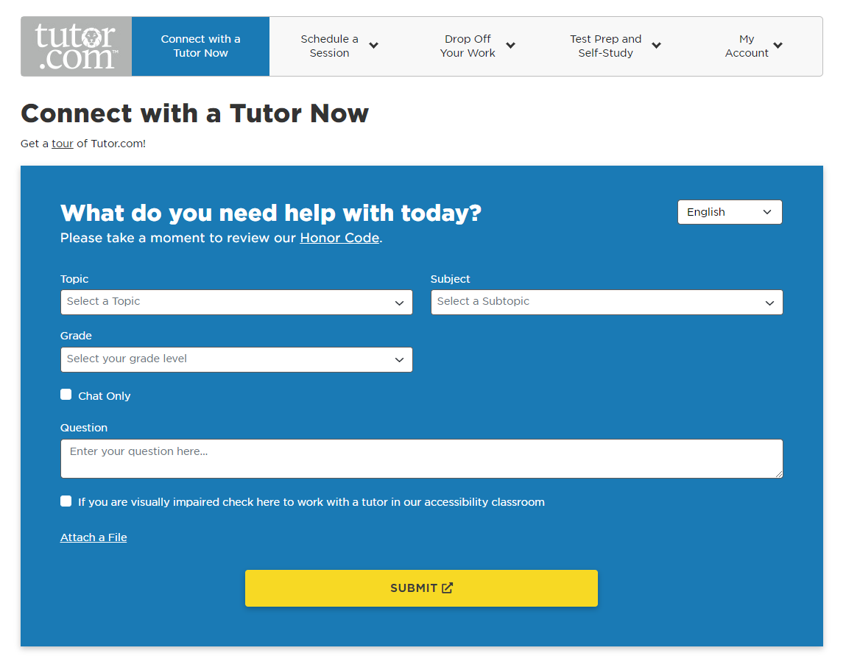
Connecting With a Tutor
Subjects available 24/7 except as noted
English and Spanish

Slide 8
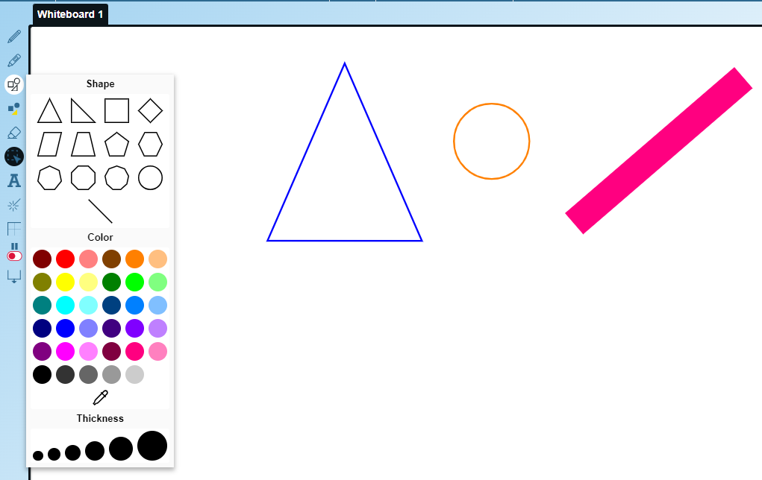
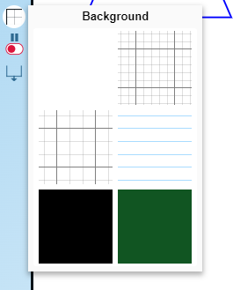
Classroom Connection
Interactive Whiteboard
Drawing and writing tools
Paste or import images
Change background
Drag and drop shapes and formulas
Open multiple whiteboards

Slide 9
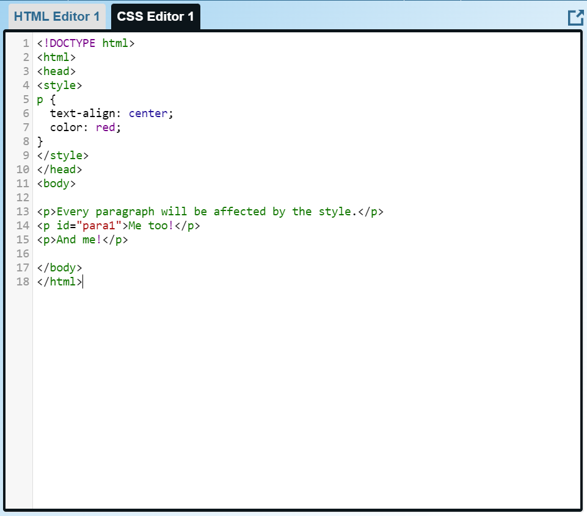
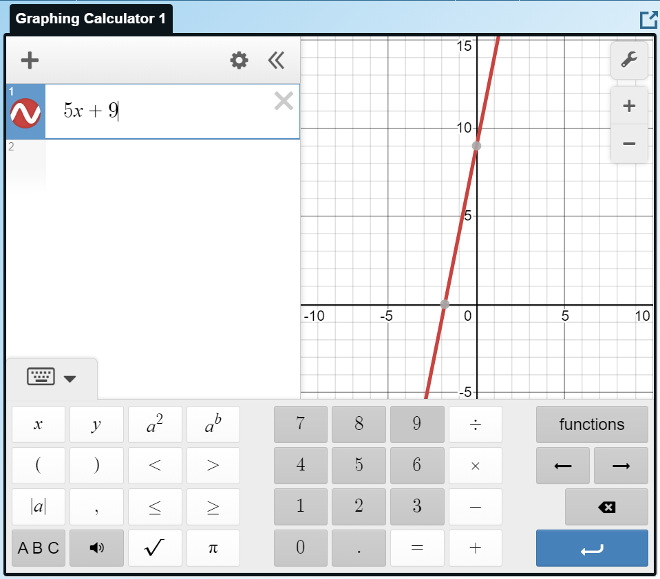
Classroom Connection
Web resource sharing
Graphing calculator
Code editor

Slide 10
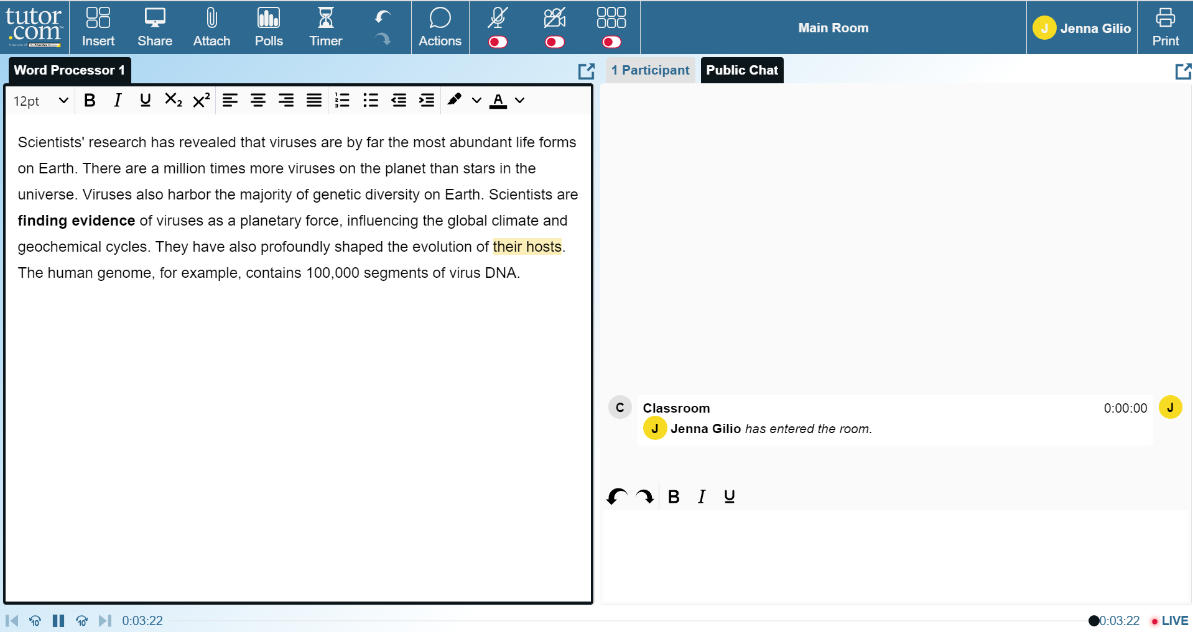
Classroom Connection
File SHARING
Word, Excel, PowerPoint, TXT, HTML, PDF, JPG, BMP, PNG (1 MB max)
Two-Way text editor
Both student and tutor can modify text

Slide 11
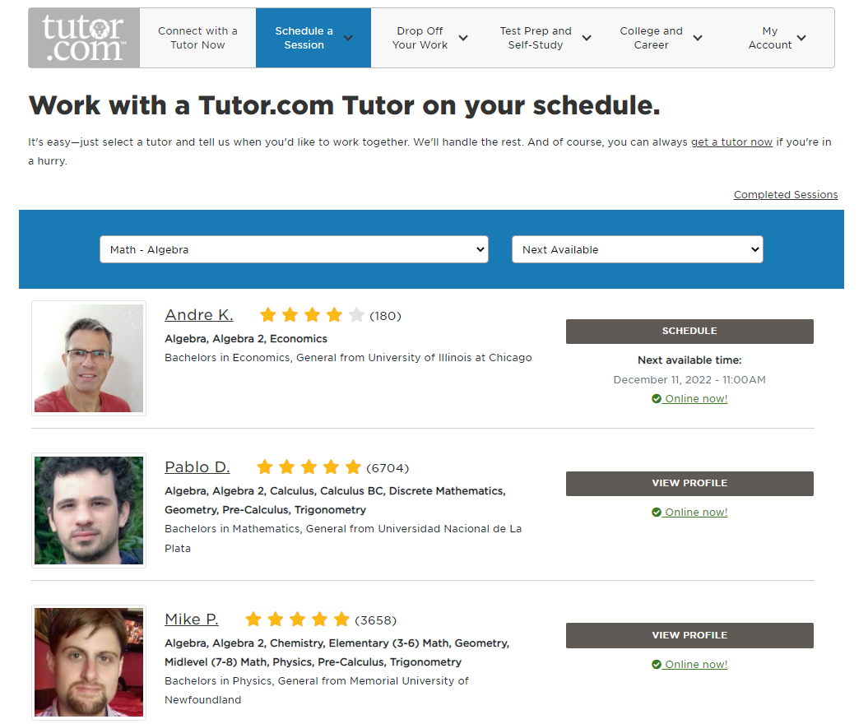
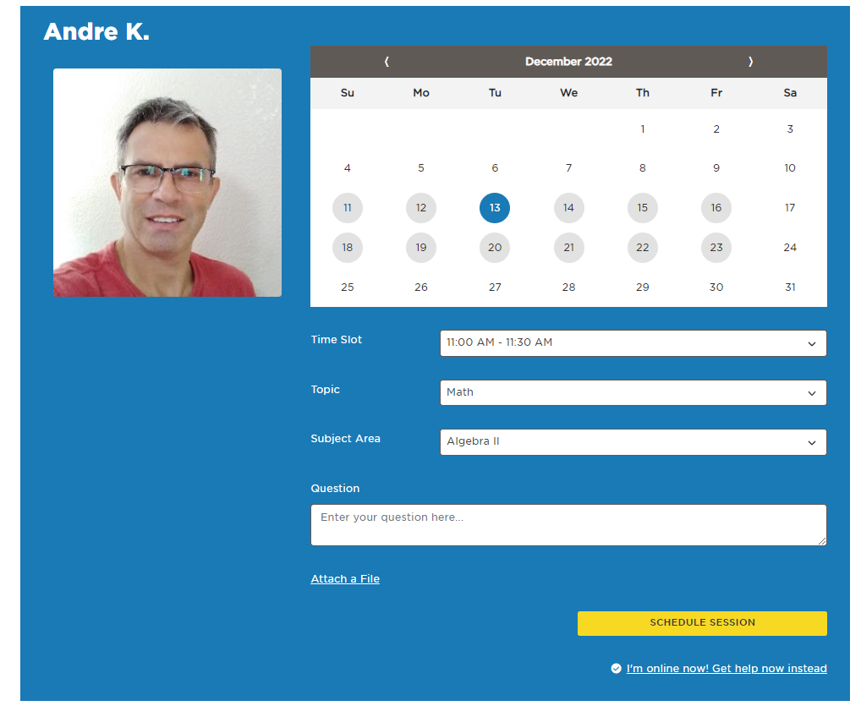
Scheduling a Session with a Tutor
Find a tutor in your desired subject and schedule a time to meet

Slide 12
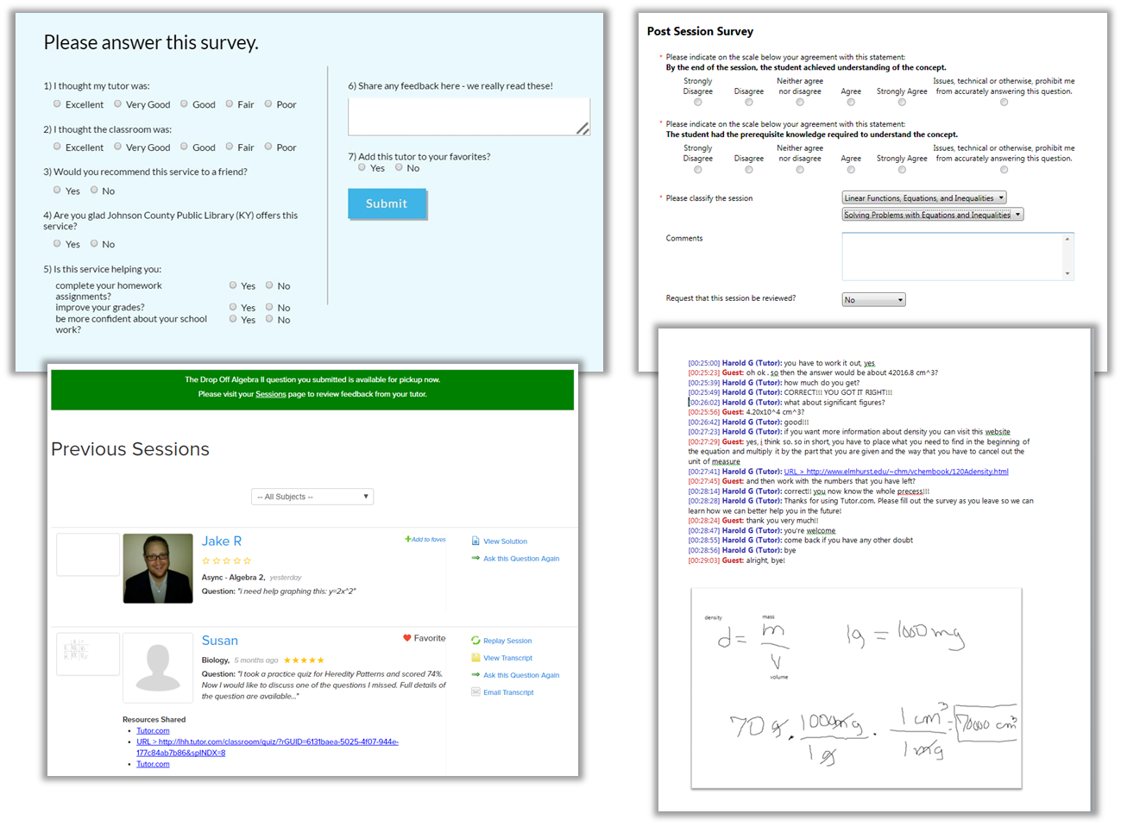
Post-Session
Student & Tutor Surveys
Tutor gives feedback on student
Students give feedback on their tutor
My Account Features
Session transcripts available to students
Students can tag and reconnect with favorite tutors
Virtual Locker for document storage and retrieval
Notes:
At the end of every session, both the student and the tutor will complete surveys. The tutor assesses learner needs and this information contributes to the reports that faculty members can view
And the students also have an opportunity to provide feedback on their tutor.
Students will always be able to go back and review previous sessions, including transcripts and replays, and they’ll have a virtual locker where they can store and retrieve documents.
Students are also able to mark tutors as their “favorite,” increasing their chances of working with them again in the future.

Slide 13
Tutoring Students With Challenges
Notes:
Our tutors are familiar and comfortable working with all students. Each tutor differentiates their approach based on student needs and our online classroom is equipped with tools to support all learners. For example, students have the option to connect to their tutor using the voice tool or to solely communicate via chat. The classroom whiteboard includes many additional ways of communicating, such as drawing, using diagrams, and more. And our classroom is compatible with screen readers.
Talking points:
Voice tool
Students with autism like chat
Tutors differentiate approach based on student needs
Change approach to meet the student where they are
Accessibility tools - screen readers work
Whiteboard tools – lots of ways to communicate

Slide 14
Support For English Language Learners
Clarify the question or assignment thoroughly
Decode the directions or learn unfamiliar terminology
Break concepts into smaller steps
Check for understanding by stopping and talking
Use appropriate pacing and flexible approaches
Guide and use examples
Notes:
Tutor.com also employs designated tutors to work with English Language Learners. Students can connect with our tutors to work on ELL reading, writing, and speaking. And students can connect with Spanish-speaking tutors for help in their core subjects, such as math, science, etc., Tutors will work with students to clarify their assignments, break concepts down into small steps, help students learn new terminology, and more.

Slide 15
Questions, comments, or concerns?
Reach out to your campus program manager, JRockway @citytech.cuny.edu

