Slide 1

Tutor.com 101
For Faculty
Incorporating online tutoring into instruction & student support
Welcome CUNY City Tech!

Slide 2

agenda
Brief Background on Tutor.com
Overview of Student Experience
Our Tutors & Methodology
Resources
Q/A

Slide 3

Company overview & experience
Founded 1998 in New York City
More than 22 million sessions served
4,000+ active, vetted tutors
Currently partnering with more than
375 colleges and universities
System-wide coverage for University System of Georgia, Ivy Tech Community College, MN State Colleges, U HI and HI Community Colleges, Salt Lake CC, and Virginia CC System
Exclusive provider of online tutoring to U.S. DOD service members and their dependents

Slide 4

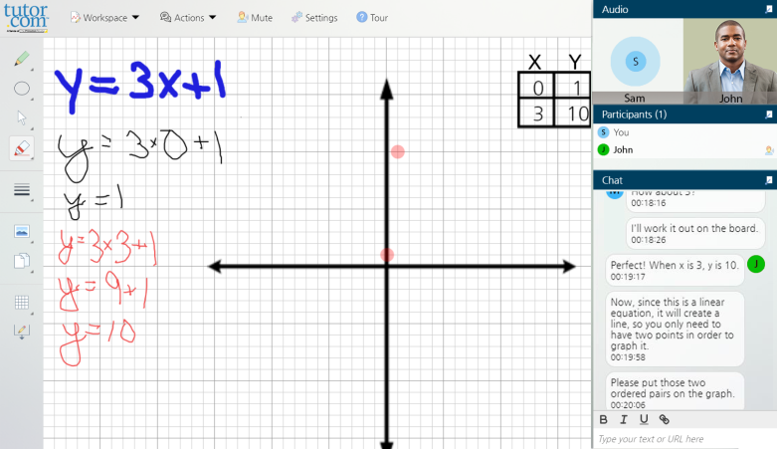


Your Tutor.com Services
Academic Tutoring
From Tutor.com
Self-Study Content and Graduate School Test Prep From The Princeton Review
Career Services
& Student Success
On-demand and Scheduled tutoring in 250+ subjects, plus drop-off writing review from Tutor.com expert tutors
A variety of self-paced test prep content and other asynchronous self-study resources
Options for Career Help and Student Success Coaching

Slide 5










250+ Available Subjects
Math* | Science* | English & Literature | Writing | Social Sciences*
Computer Literacy & Science | Foreign Languages | Introductory Business | Content for grad exams | Study skills COACHING*
 | Optional Add-On Subject Packages | Drop-Off REVIEW Services | Nursing
*Bilingual Spanish-speaking tutors are available in these subject areas

Slide 6
Background on Tutor.com Tutors

Slide 7
Becoming a tutor.com Expert Tutor
Over 200k
per year
Register
Pass subject exams
1-on-1
interview
Successful applicants
Meet minimum qualifications
18%
1.2%
4.8%
9.5%
Applicants must go through a rigorous background check

Slide 8
Quality Assurance & Support

Slide 9
The Student Experience
Notes:
Now let’s look at what your students will experience when they log on to Tutor.com.

Slide 10
How You Access Tutor.com
Log in
To Blackboard
Scroll
Down to My Organizations
Click
On Here if You Need Tutoring
Click
On How to Schedule a Tutor

Slide 11
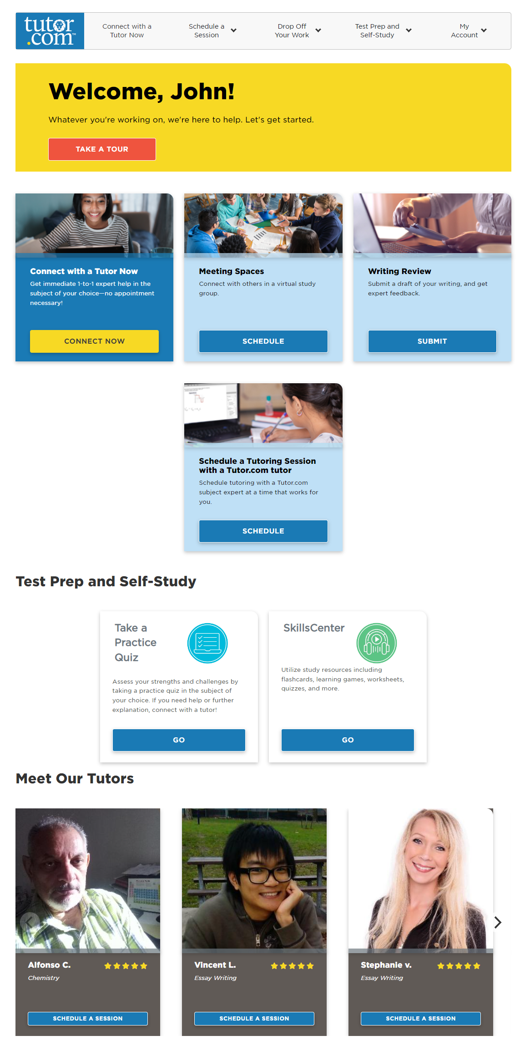
New Student Home Page

Slide 12
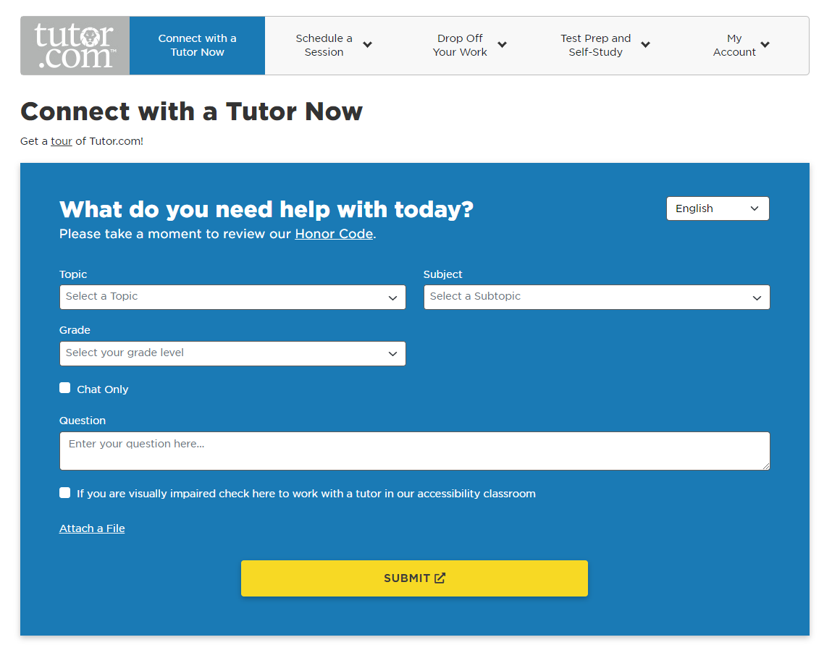
Connecting With a Tutor
Subjects available 24/7 except as noted
English and Spanish

Slide 13
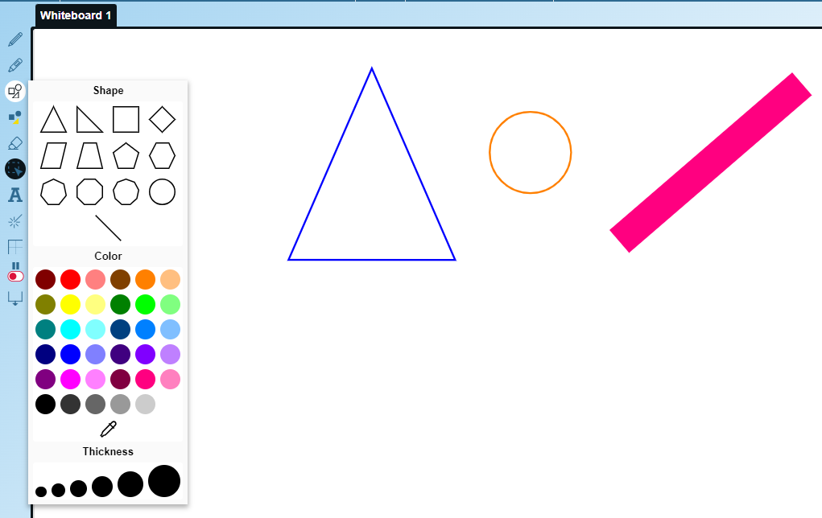

Classroom Connection
Interactive Whiteboard
Drawing and writing tools
Paste or import images
Change background
Drag and drop shapes and formulas
Open multiple whiteboards

Slide 14
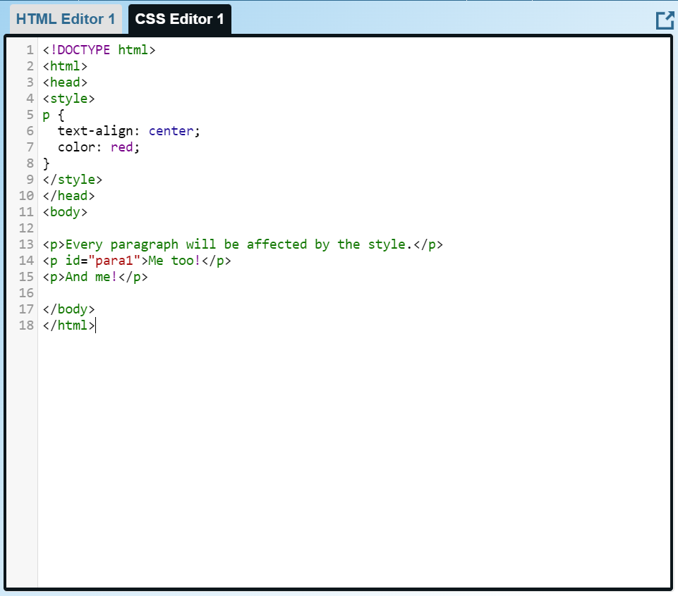
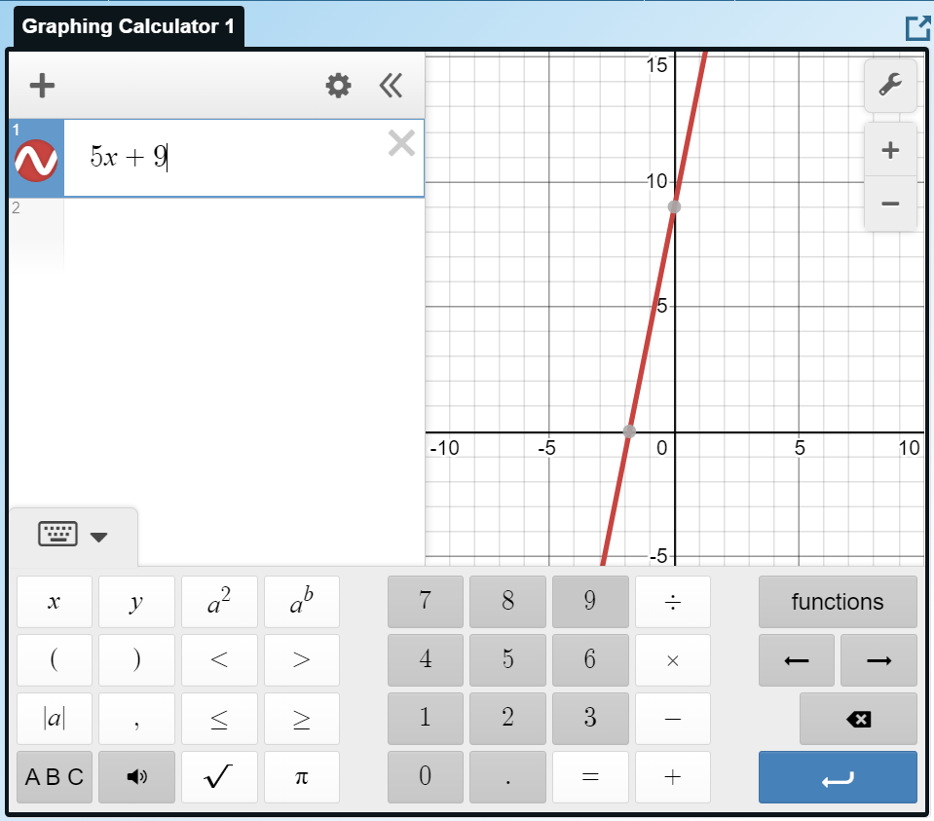
Classroom Connection
Web resource sharing
Graphing calculator
Code editor

Slide 15
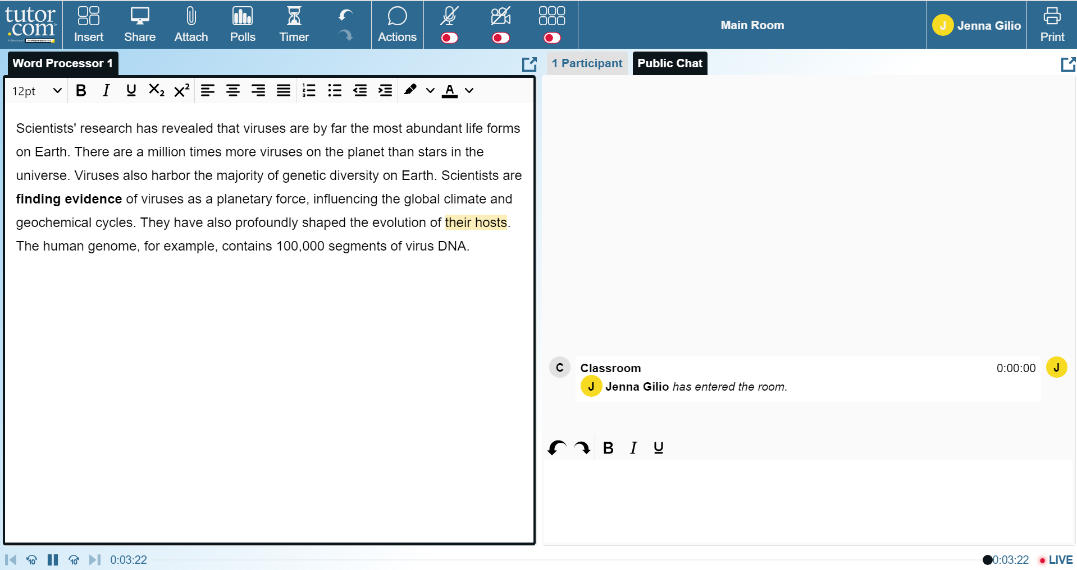
Classroom Connection
File SHARING
Word, Excel, PowerPoint, TXT, HTML, PDF, JPG, BMP, PNG (1 MB max)
Two-Way text editor
Both student and tutor can modify text

Slide 16
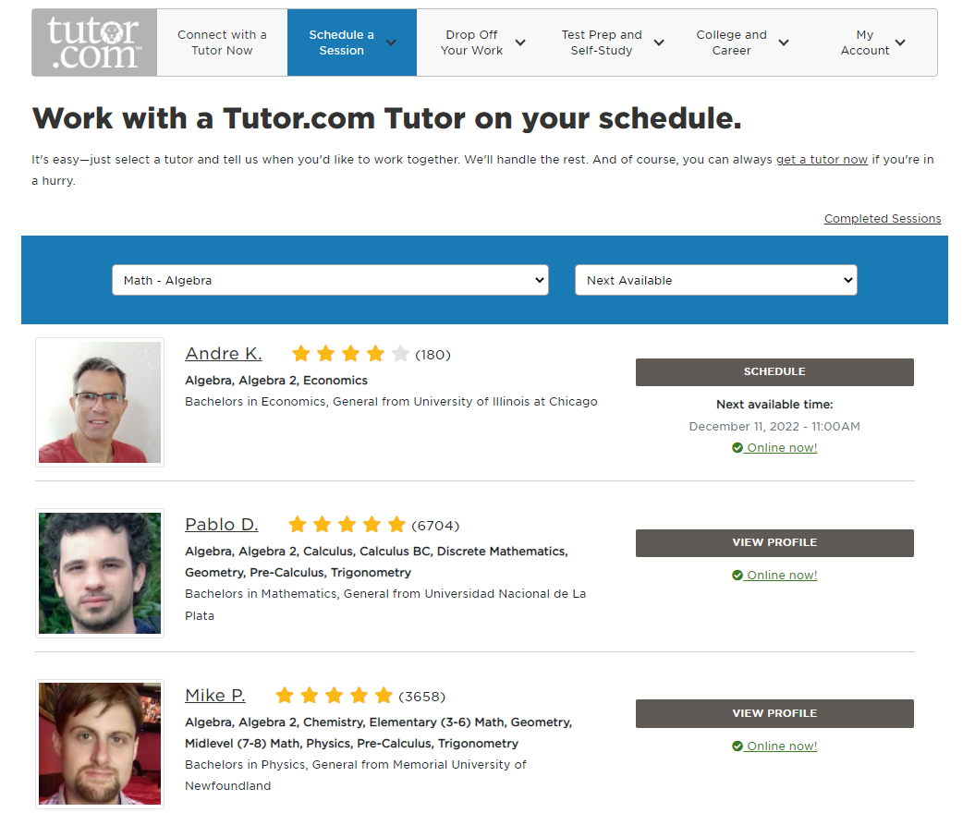
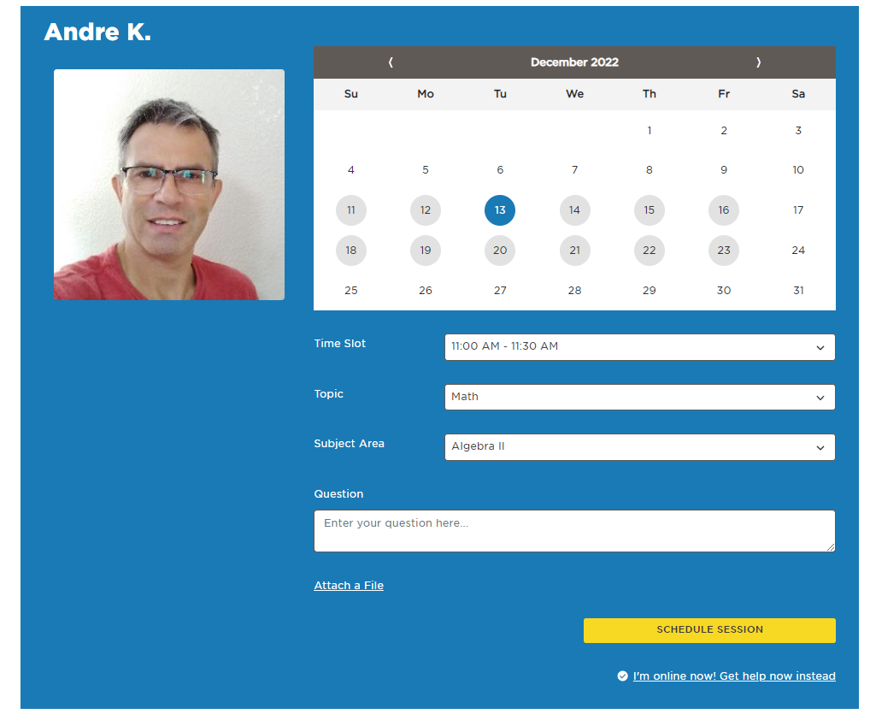
Scheduling a Session with a Tutor
Find a tutor in your desired subject and schedule a time to meet

Slide 17
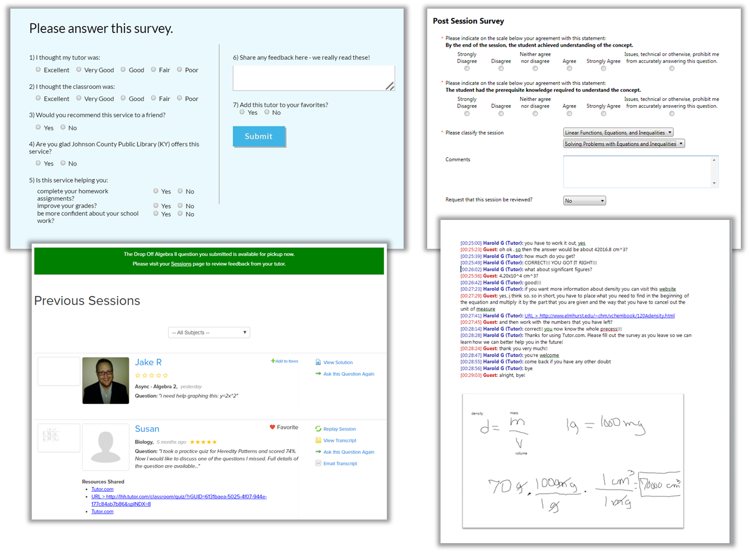
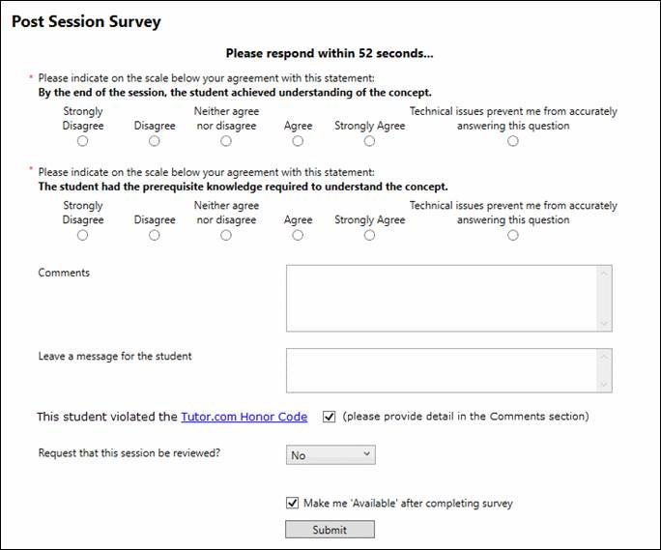
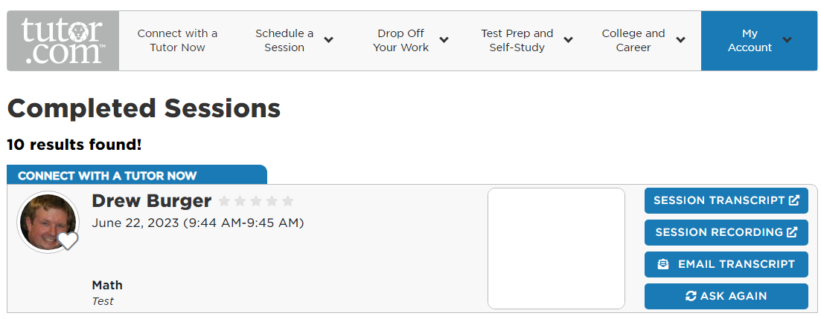
Post-Session
Student & Tutor Surveys
Tutor assesses learner needs
Students give feedback
Available in your reports
My Account Features
Session transcripts available to students
Students can tag and reconnect with favorite tutors
Virtual Locker for document storage and retrieval

Slide 18
Tutoring Students With Challenges
Notes:
Our tutors are familiar and comfortable working with all students. Each tutor differentiates their approach based on student needs and our online classroom is equipped with tools to support all learners. For example, students have the option to connect to their tutor using the voice tool or to solely communicate via chat. The classroom whiteboard includes many additional ways of communicating, such as drawing, using diagrams, and more. And our classroom is compatible with screen readers.
Talking points:
Voice tool
Students with autism like chat
Tutors differentiate approach based on student needs
Change approach to meet the student where they are
Accessibility tools - screen readers work
Whiteboard tools – lots of ways to communicate

Slide 19
Support For English Language Learners
Clarify the question or assignment thoroughly
Decode the directions or learn unfamiliar terminology
Break concepts into smaller steps
Check for understanding by stopping and talking
Use appropriate pacing and flexible approaches
Guide and use examples
Notes:
Tutor.com also employs designated tutors to work with English Language Learners. Students can connect with our tutors to work on ELL reading, writing, and speaking. And students can connect with Spanish-speaking tutors for help in their core subjects, such as math, science, etc., Tutors will work with students to clarify their assignments, break concepts down into small steps, help students learn new terminology, and more.

Slide 20
Early Alerts
Prerequisite Knowledge
Student came into the session lacking the prior knowledge they would need to solve the problem they came in with
Tutor needs to address this prior knowledge before they can help the student with their request
Content Mastery
By the end of the session the student did not achieve understanding of the concept.
Unusually Long Session
If a session goes 75% longer than the average for that subject, our system will automatically trigger an alert
Frequent Subject Request
Student has requested the same topic 7+ times in 7 days
This alert is automatically triggered by our system

Slide 21

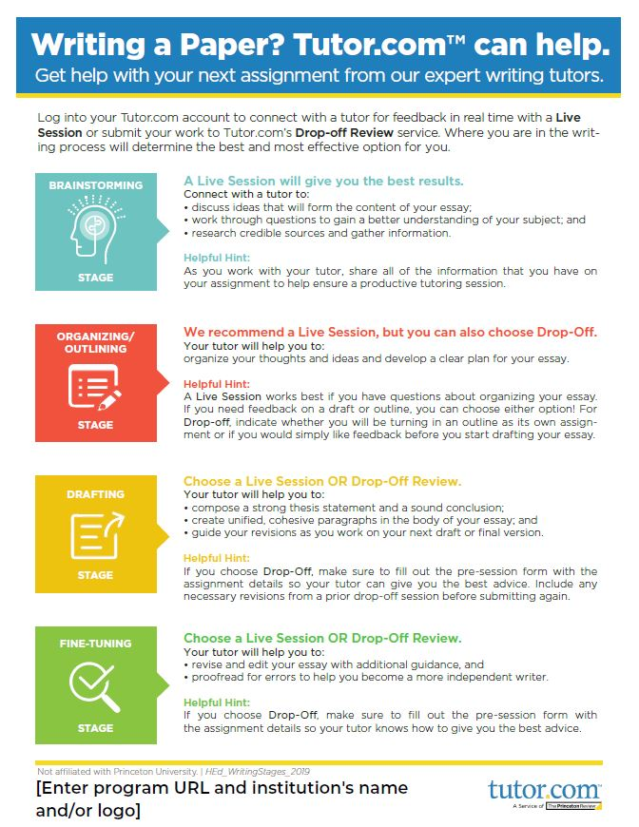
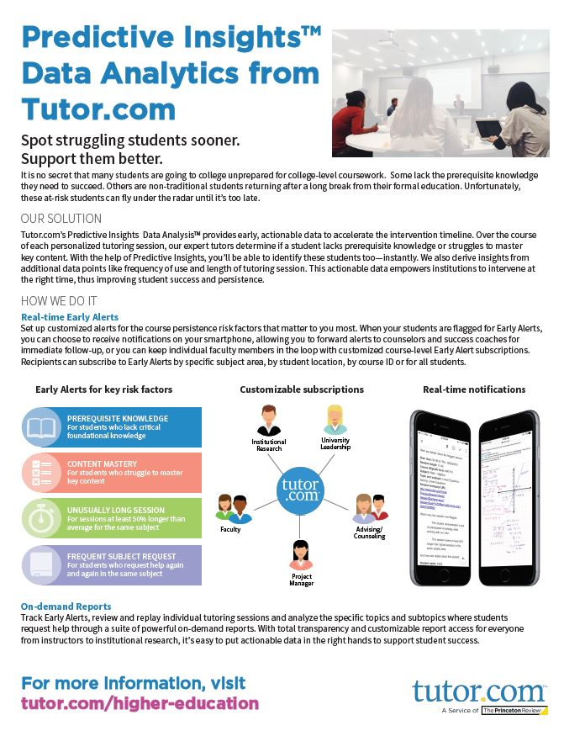
Promotional Materials
Digital media and promotional assets
Student handouts and videos
Information and guides for faculty
Trainings and webinars
www.tutor.com/clientcarehed

Slide 22


Engage Your Students
Share Tutor.com with your students
Announce at the beginning of the semester and regularly throughout
Add access information and uses to your syllabus
Social media
University websites/learning management systems
Physical signage (banners, posters, flyers)
Videos

Slide 23
Questions?
Judith Rockway, ALC Director,Jrockway@citytech.cuny.edu

